Slide 1

Welcome to The Inventors Hub!
Tuesday 9th September

Slide 2
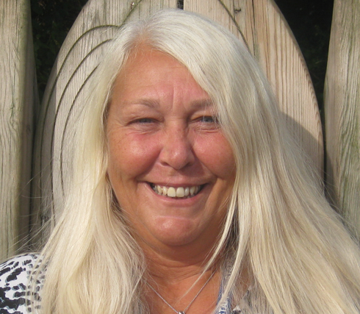
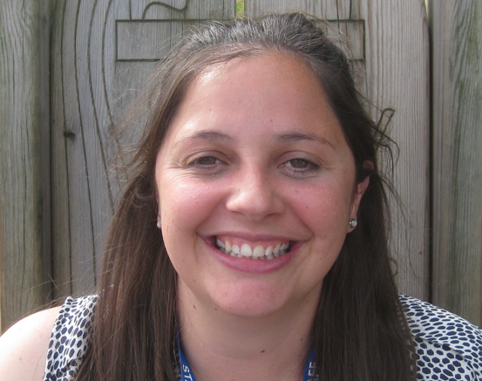
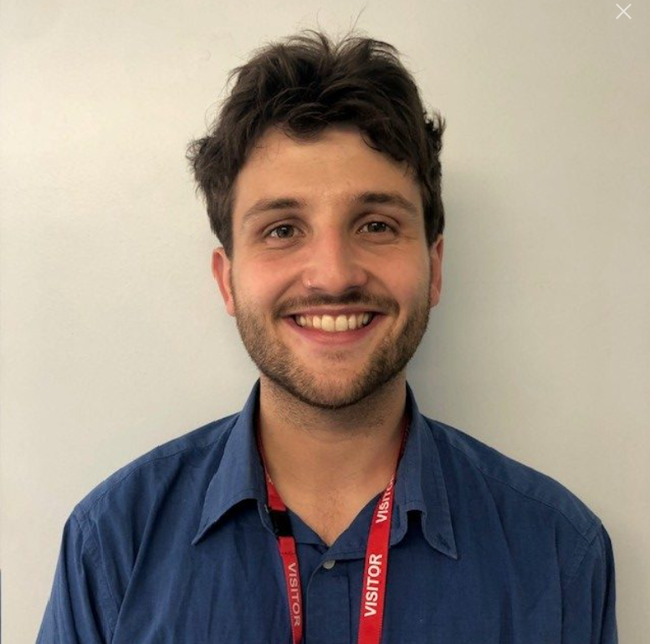
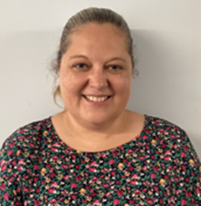
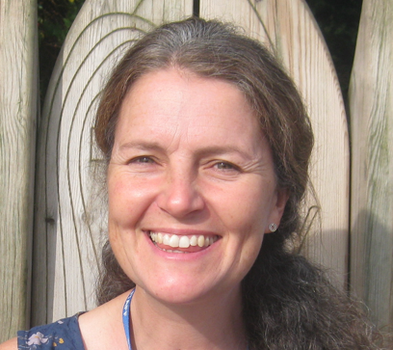
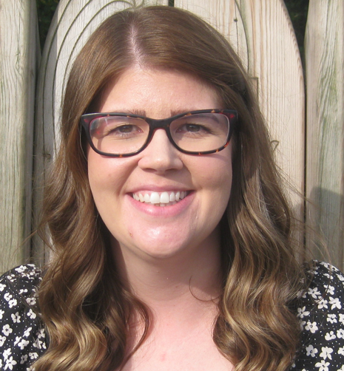
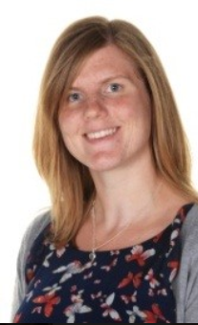
MEET THE TEAM
Mrs. Beach
Mr. Coll
Miss Richards
Miss Haylett
Mrs. Mullick
Miss Staines
Mrs. Gough

Slide 3
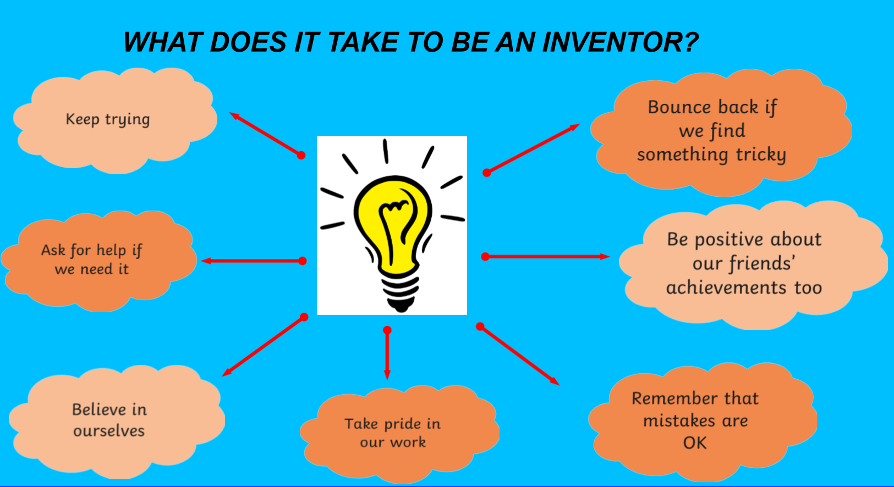

Slide 4
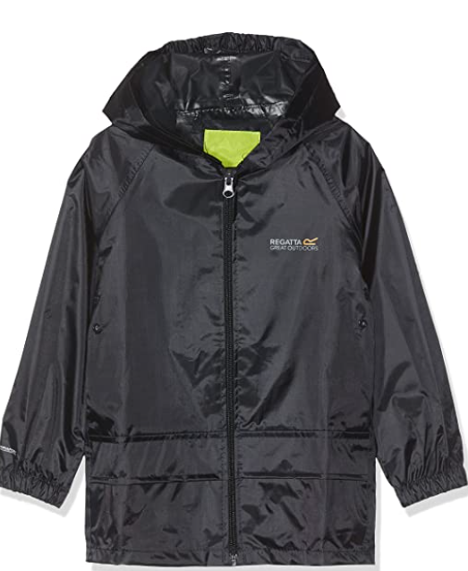
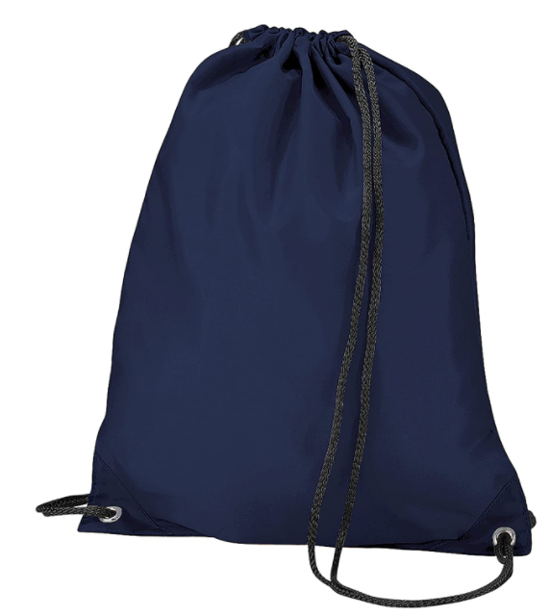
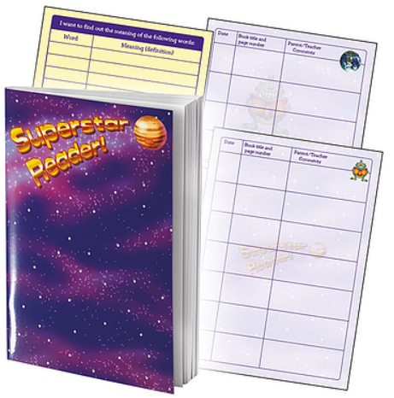

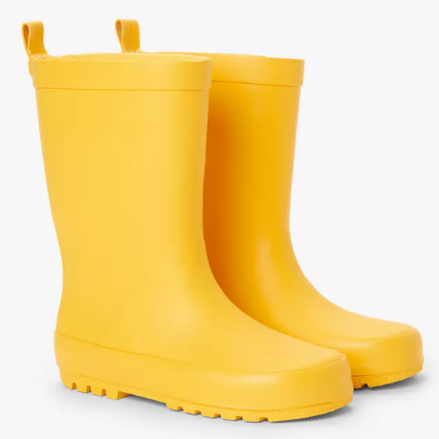
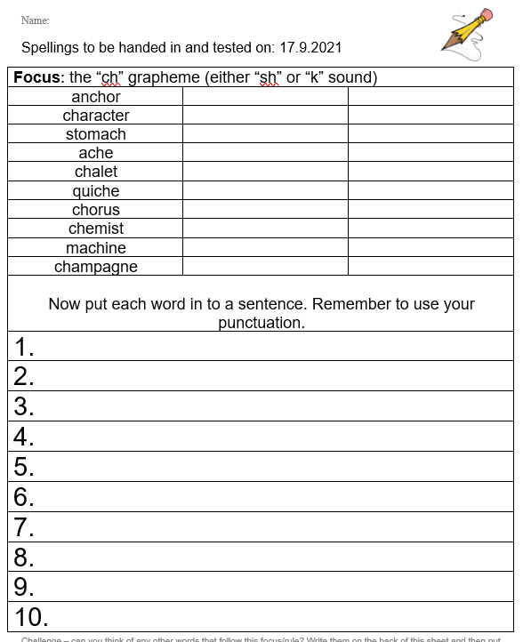
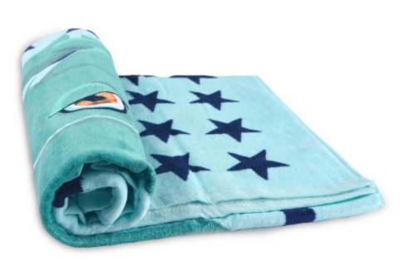
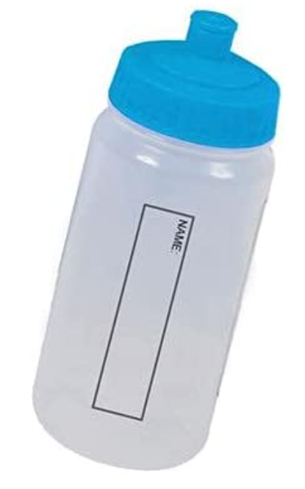
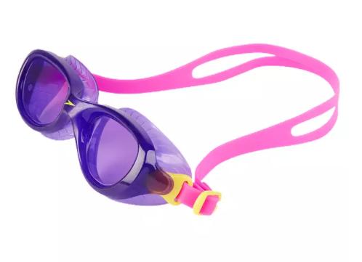

Things to bring to school…
WATERPROOF & WELLIES
READING RECORD & READING BOOK
(Checked on Monday)
PE KIT
YEAR 4 (Monday &Wednesday)
YEAR 3 (Wednesday)
SWIMMING BAG (Thursday – Y3)
WATER BOTTLE / FRUIT
SPELLINGS (Friday)
Notes:
ALICE

Slide 5
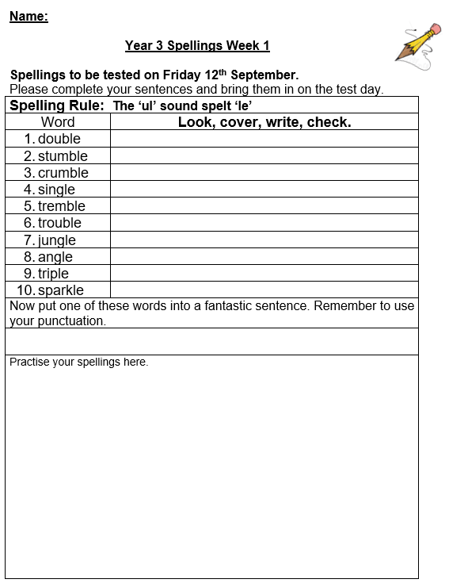
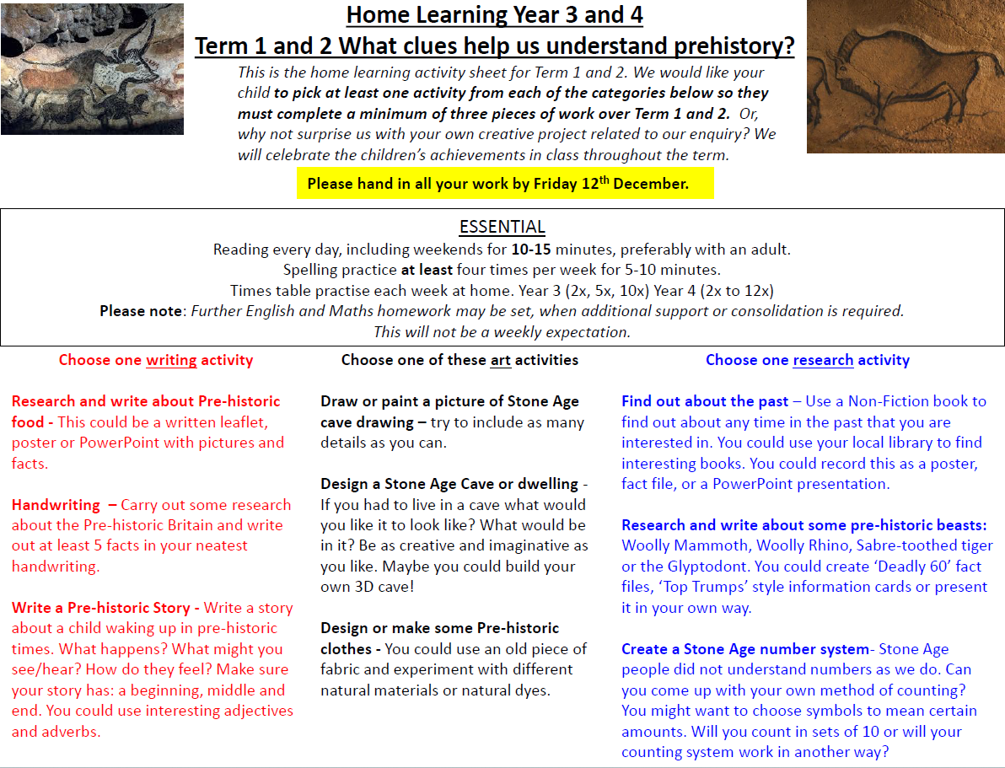
HOME LEARNING
SPELLINGS (Friday)

Slide 6


Slide 7
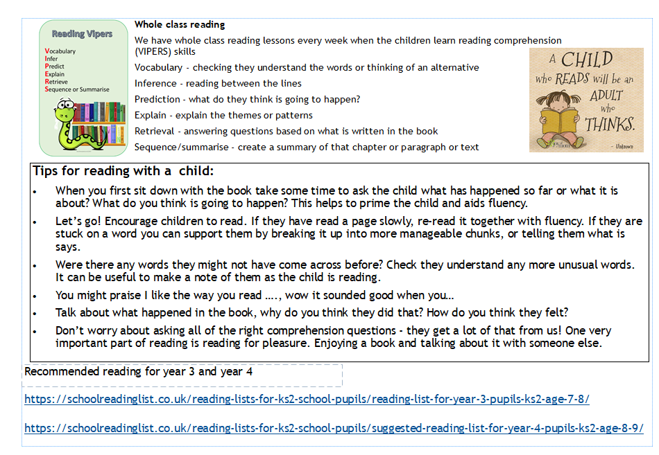

Slide 8

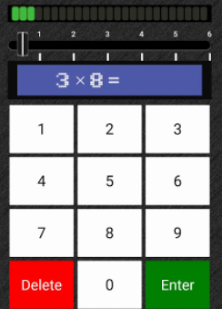
X TABLES
Year 4 GOVERNMENT TESTS (June 2026)
All tables up to 12 x 12
6 seconds
TT Rock Stars
‘SOUNDCHECK’
-94% achieved 22 or more in the final test

Slide 9
