Slide 1
Parent Writing workshop
21.01.25

Slide 2
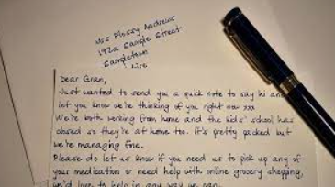
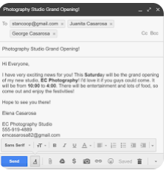
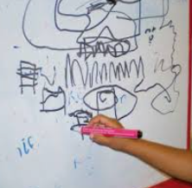
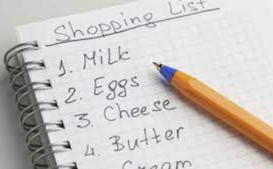
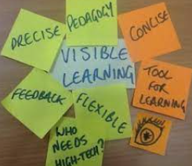
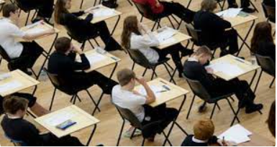
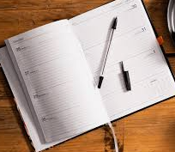
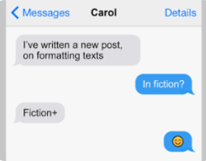
The meaning of writing to you

Slide 3
Writing
Before children can hold a pencil or write, they need to be physically ready.
Children need regular opportunities to develop their gross motor and fine motor skills.
As young children develop the muscles in their hands, they develop the strength they need for the fine motor skill needed for writing.
Strengthening the upper body by accessing wide circular movements from the shoulder is important.
Children need to be able to articulate their ideas verbally first.

Slide 4
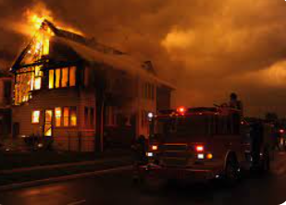
I see …
I think …
I wonder …

Slide 5
Examples of what a child might write using their phonic knowledge.
- I see fIr or I see fighr I see fire
fIrfItr or fighfightur firefighter

Slide 6
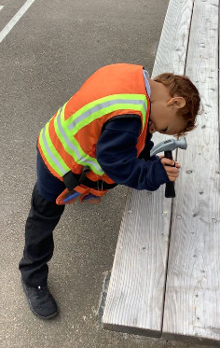
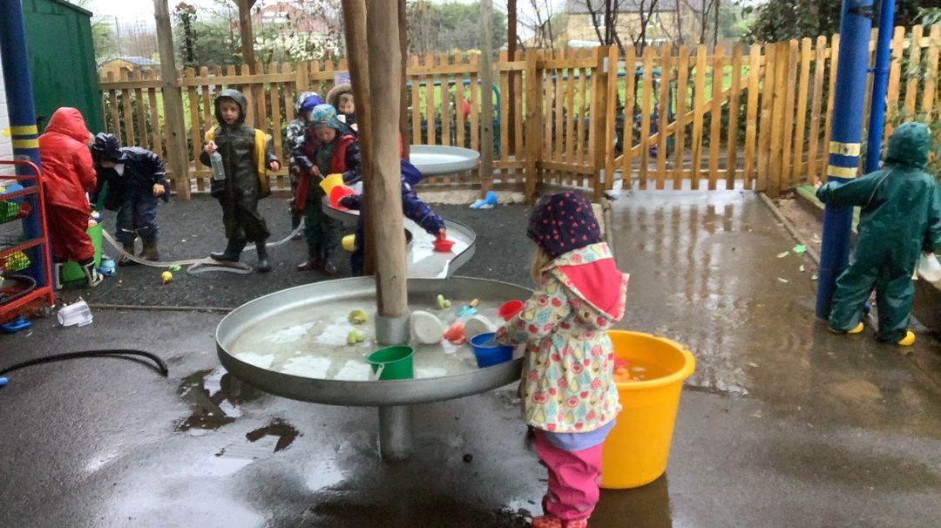
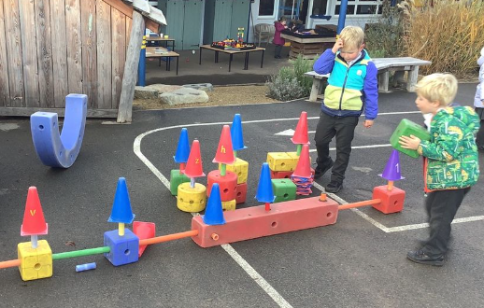
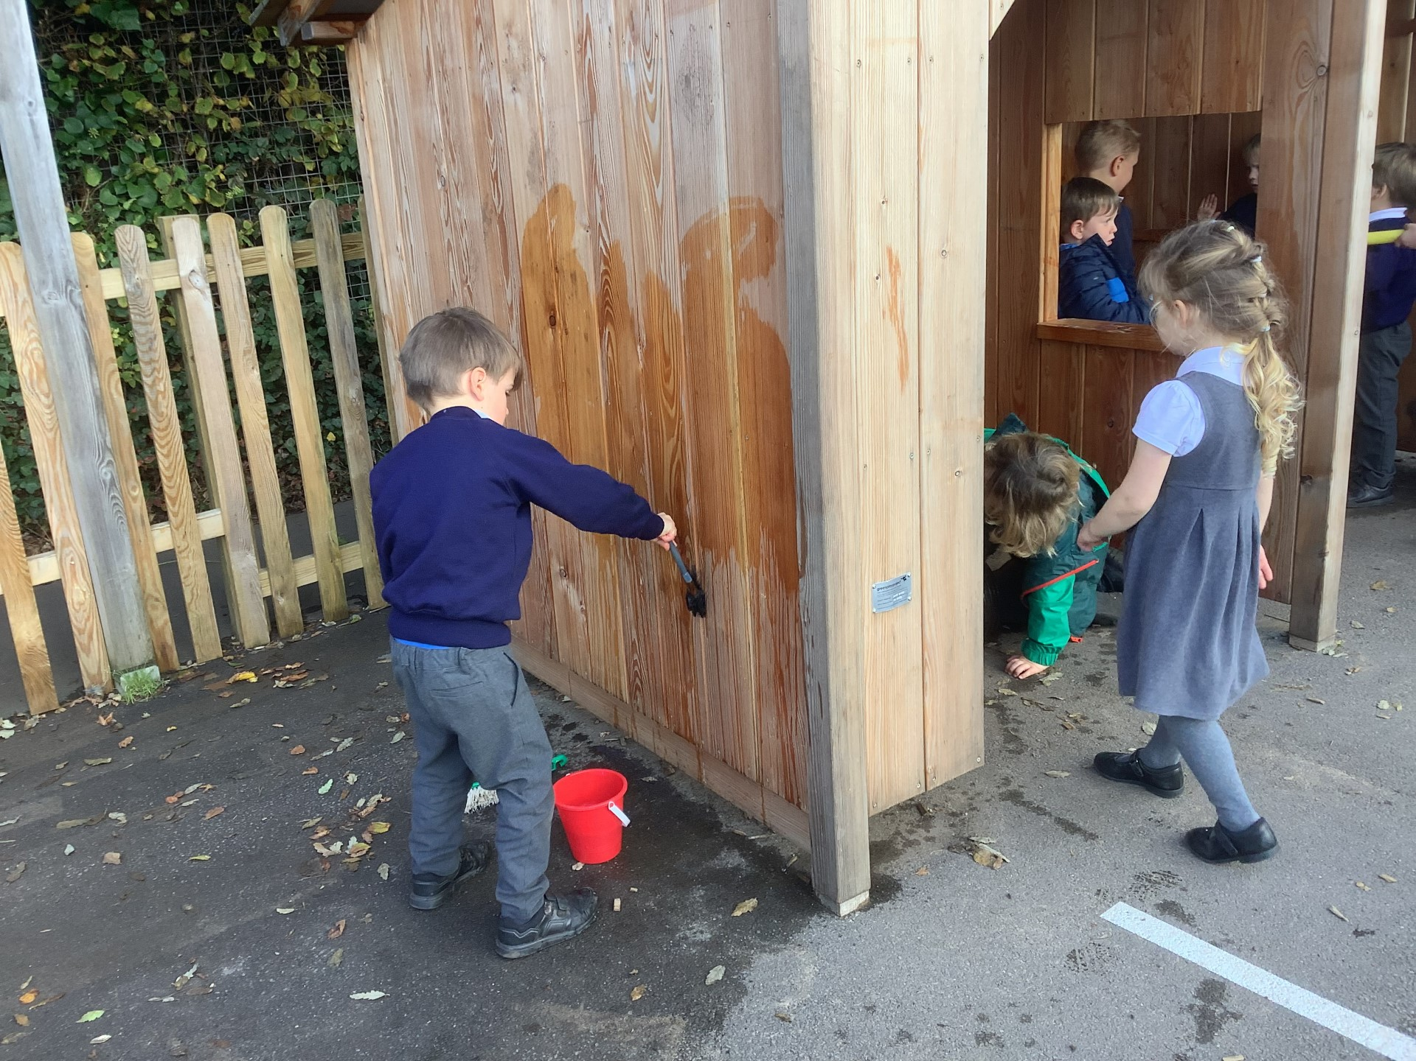
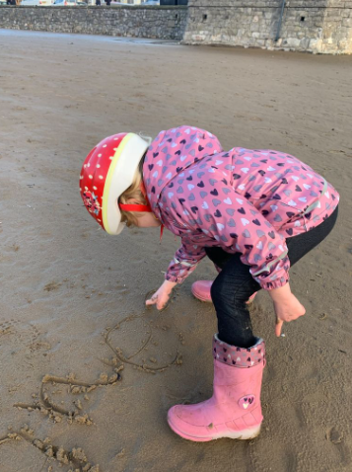
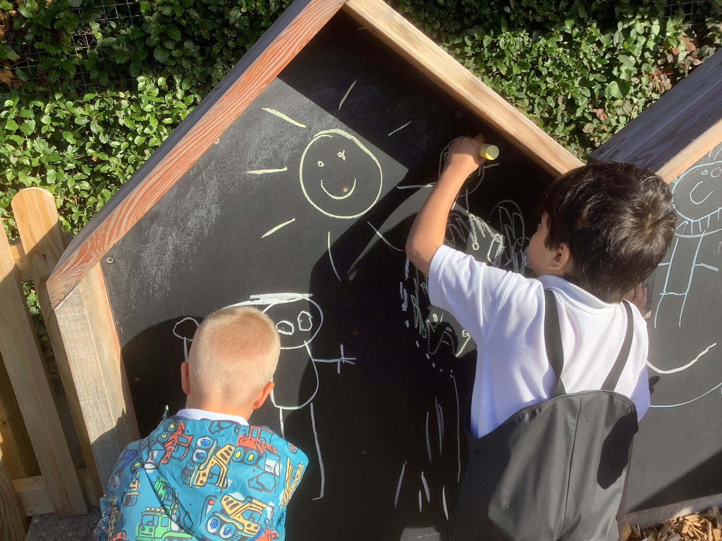
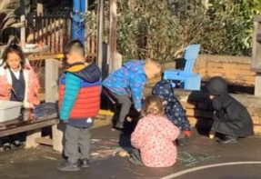
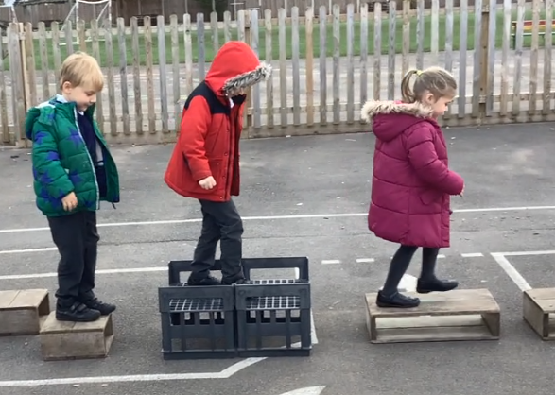
Examples of gross motor activities

Slide 7
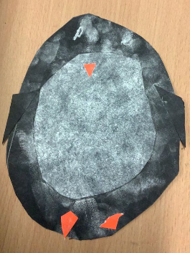
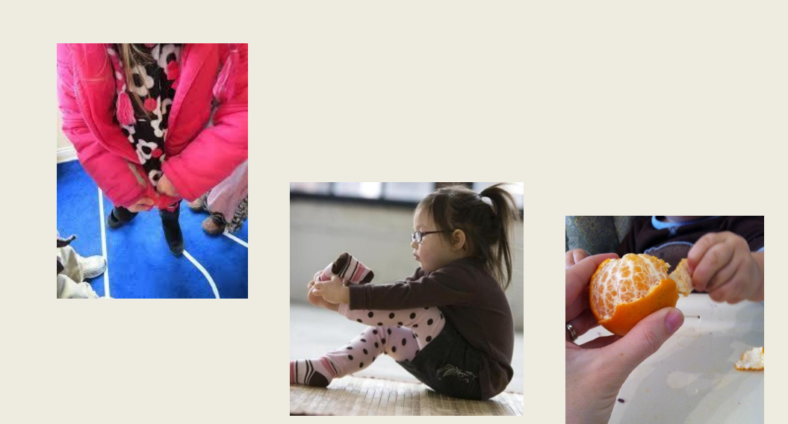
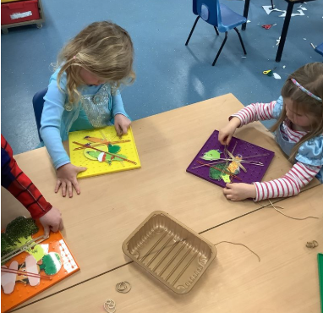
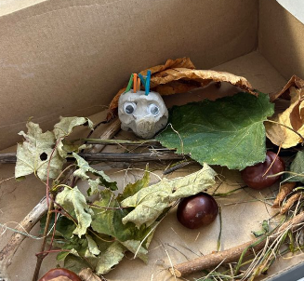
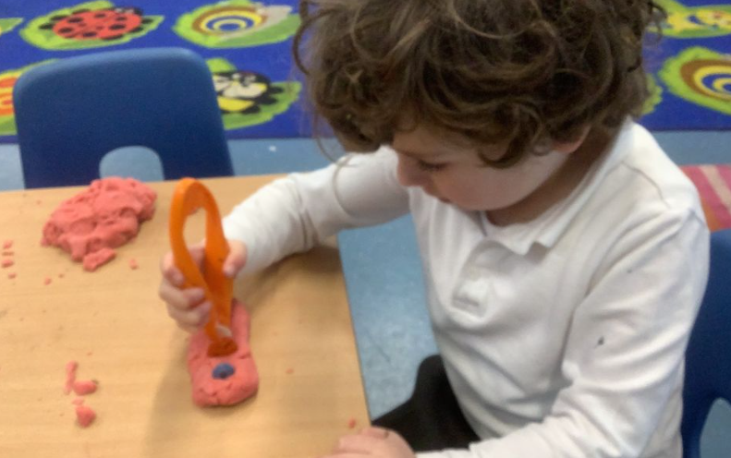
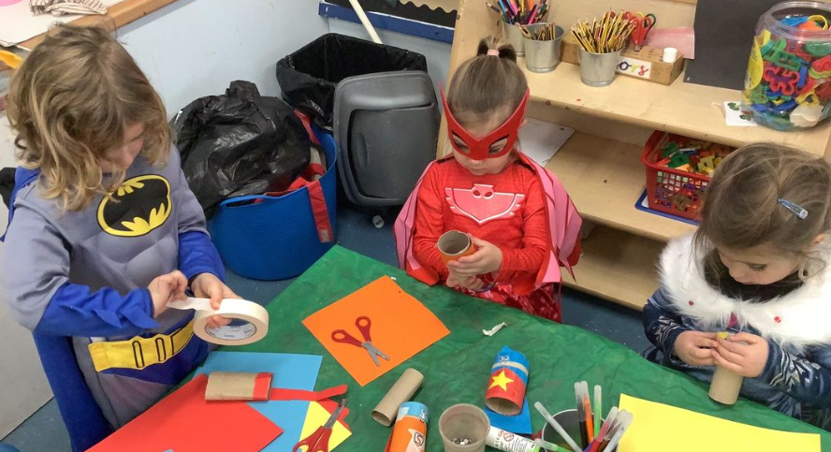
Examples of fine motor activities

Slide 8
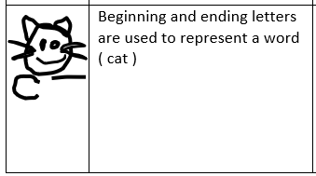
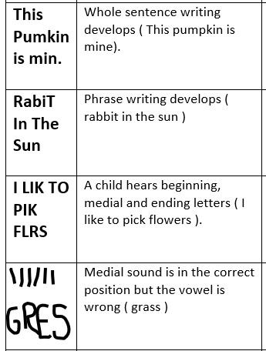
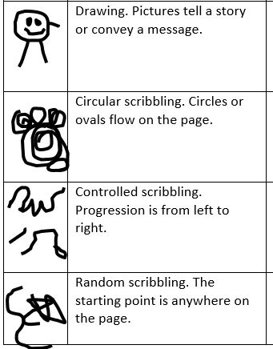
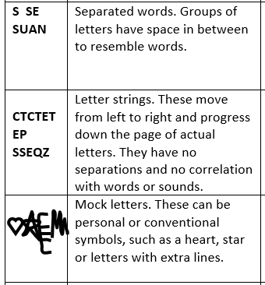
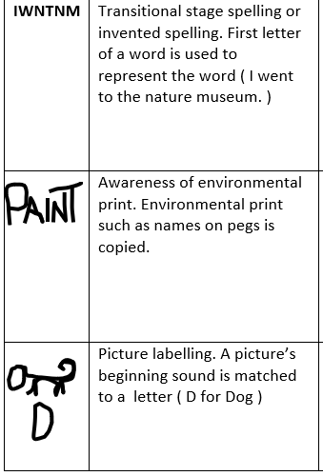
Emergent writing

Slide 9
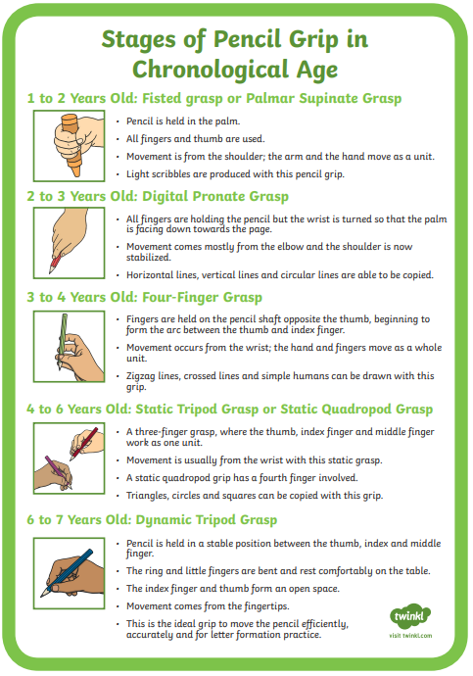

Slide 10
The importance of letter formation
Moving forward
Capital letters
Handwriting scheme (ULS)

Slide 11
Our role as adults
Be a good role model.
Don’t put too much pressure on the child.
Value all pieces of writing
Celebrate successes no matter how small

Slide 12
Examples of end of year expectation
Early Learning Goal – writing
Write recognisable letters, most of which are correctly formed.
Spell words by identifying sounds in them and representing the sounds with a letter or letters.
Write simple phrases and sentences that can be read by others.
Independence

Slide 13
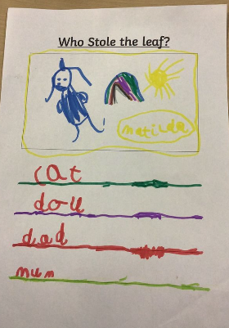
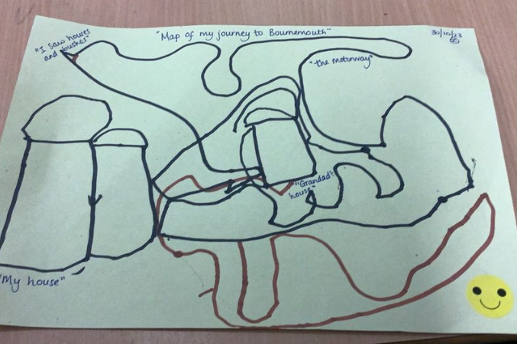
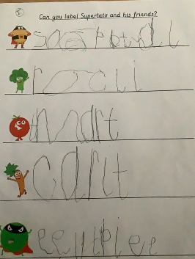
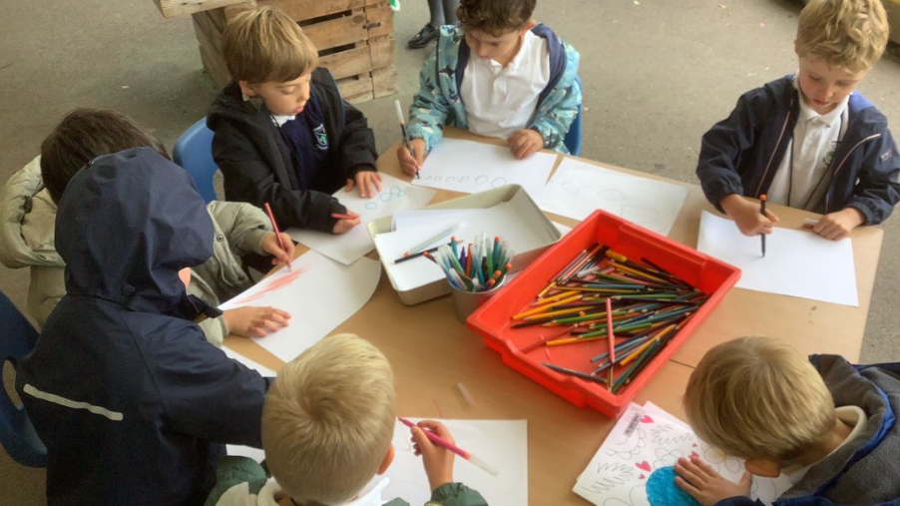
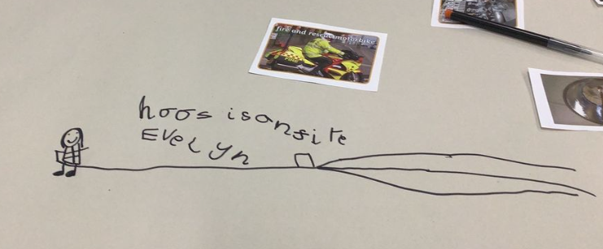
At stoke bishop writing looks like …

Slide 14
Home learning
This term we will be changing our focus on the way home learning is happening.
We will be setting a fortnightly writing challenges for your child to have a go at and displaying them on their learning board.
Next weeks challenge will be writing a list!

Slide 15
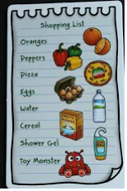
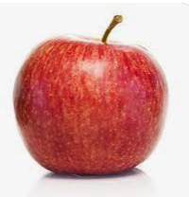
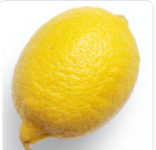
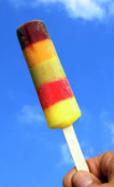
xcyg

