Slide 1
Reading and Phonics at Stoke Bishop Primary School

Slide 2
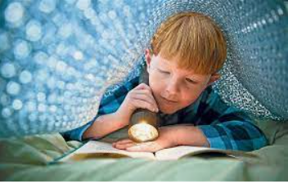
Reading
Promote the love of reading through a range of platforms
Helps children find out information
Reading the world around them
Access learning in all areas of the curriculum

Slide 3
What is phonics?
Link between the sounds we say and the letters that represent each sound.
Grapheme – the written letter or groups of letters e.g. sh
Phoneme – the sound the grapheme makes
Blending – saying phonemes together to make a word e.g. sh o p m a t
The scheme we follow at Stoke Bishop is Unlocking Letters and Sounds – further information can be found on the school website.

Slide 4
A typical phonics lesson
Sing the alphabet song
Recap the graphemes we have learnt
CEW flash card
Revisit – blending to read
Revisit – oral blending
Introduce the new GPC
Form the grapheme
Practise blending to read
Practise segmenting and writing for spelling
Write or read the caption
Revise

Slide 5
Parents as Partners
Building positive relationships between home and school is essential in developing confident young readers. Working together is vital from the very start of every child’s time in school.

Slide 6
Home Learning
We will send out the 4 phonemes and any words we have learnt this week on Fridays.
On seesaw we will put a video of how to say the phoneme correctly and with the action which goes alongside it.
We will set small activities on seesaw for the children to complete which helps them to consolidate their learning. This can be uploaded in photo or video form on seesaw or a physical copy brought in to add to their learning gallery.

Slide 7
Example activity
Can you find 5 items beginning with a in your house?
Can you write s, a, t, p -
in the bubbles in your bath
using a stick in the mud
with your magic finger

Slide 8
Reading at home
Be positive and celebrate successes
Model your love of reading!
Demonstrate how to read a text – left to right, turning pages
Ask questions about what has happened and characters feelings’
Support vocabulary, make predictions

Slide 9
Expectations at Stoke Bishop
Children will be given books that are matched precisely to your child’s phonic attainment.
They will bring home 1 phonic book and 1 sharing book a week.
We change books in animal group, your child will have a consistent day each week.
Please read the phonics book 5 x weekly.
Record it in the monkey book – children receive a stamp at the end of each week if they have read 5 times.
Please ensure your child has their reading books in school everyday.
Notes:
Have a monkey book, lilac/pink book and a sharing book

Slide 10
Why read 5 x a week ?
The more we engage in a story the more we take away from it.
It provides opportunities for children to develop a range of different skills which together helps a child become a fluent, confident reader. This allows a child to have a greater capacity for paying attention to what they have read.

