Slide 1
Welcome to The Inventors Hub!
Tuesday 10th September

Slide 2
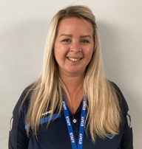
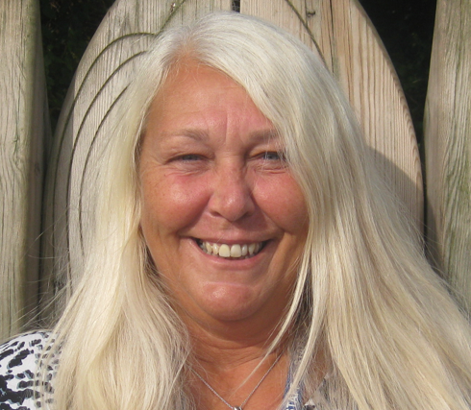
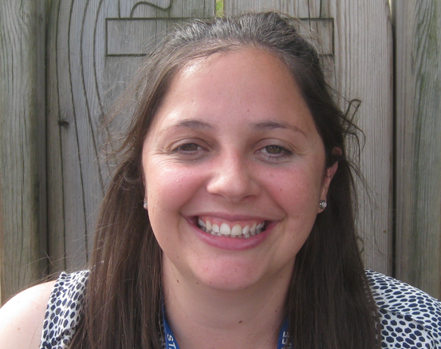
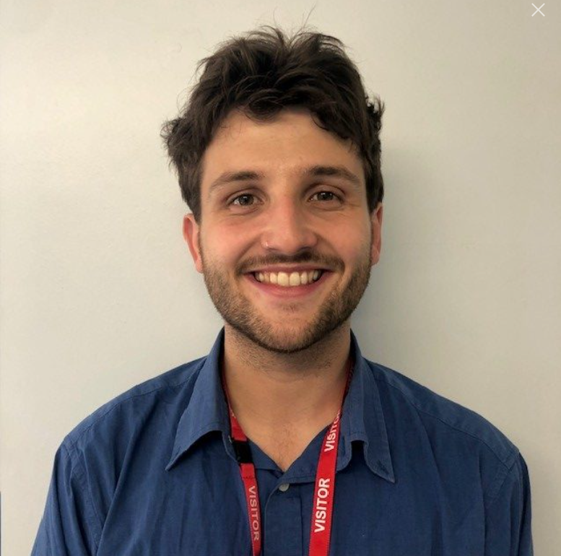
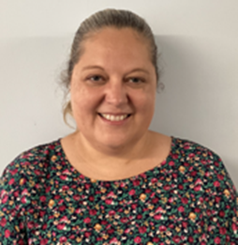
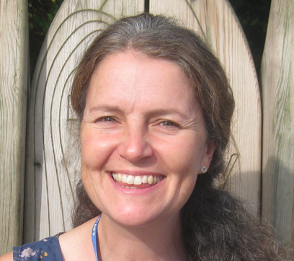
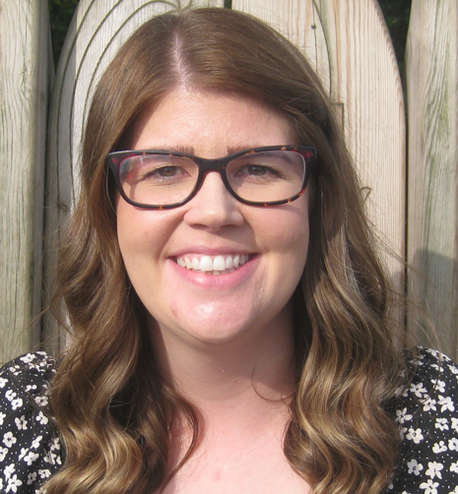
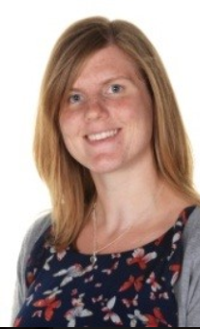
MEET THE TEAM
Mrs. Beach
Mrs. George
Miss Richards
Mr. Coll
Miss Haylett
Mrs. Mullick
Miss Staines
Mrs. Gough

Slide 4
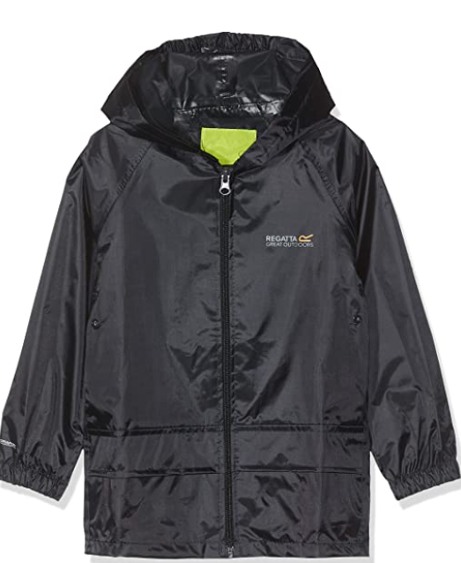
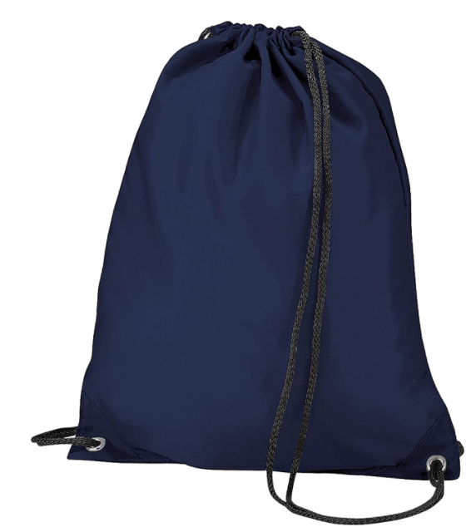
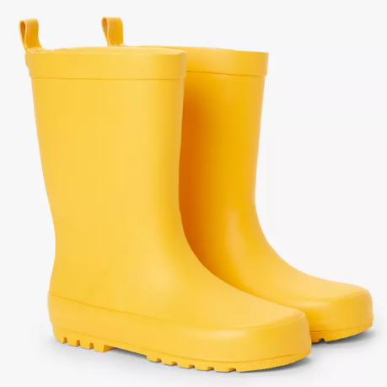
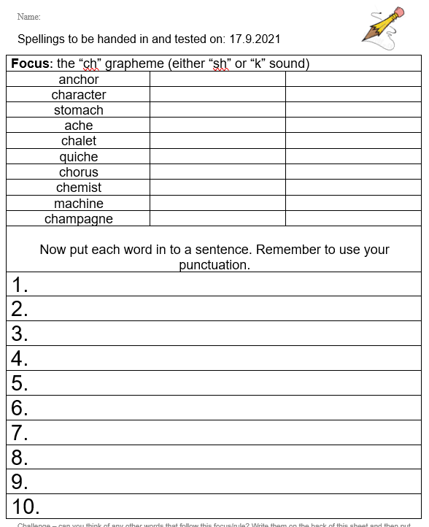
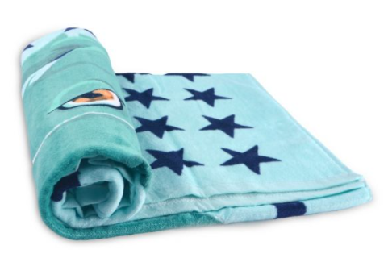
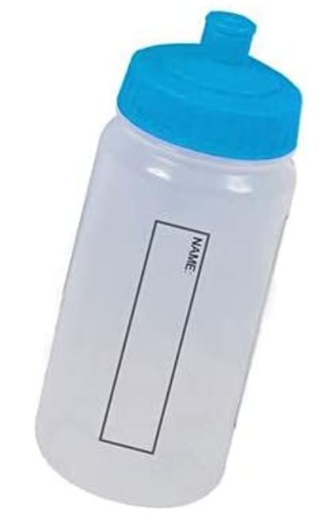
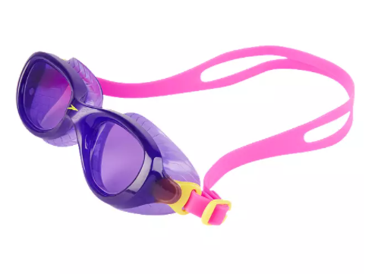
Things to bring to school…
WATERPROOF & WELLIES
READING RECORD & READING BOOK
(Checked on Monday)
PE KIT
YEAR 4 (Monday & Thursday)
YEAR 3 (Friday)
SWIMMING BAG (Thursday – Y3)
WATER BOTTLE / FRUIT
SPELLINGS (Friday)
Notes:
ALICE

Slide 5
HOME LEARNING
SPELLINGS (Friday)

Slide 7
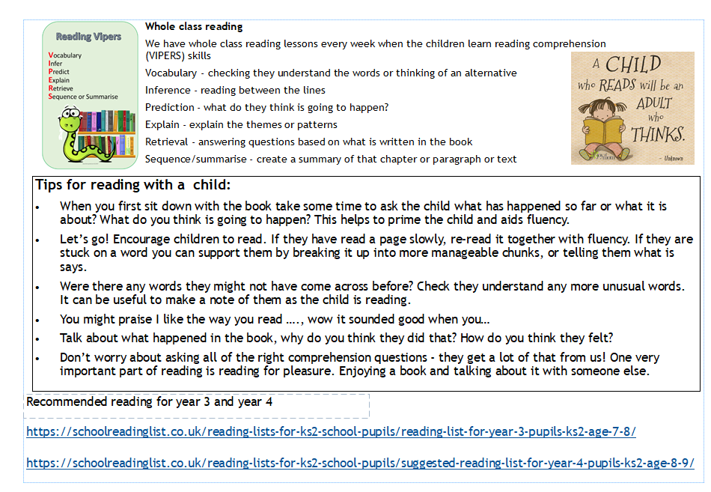

Slide 8
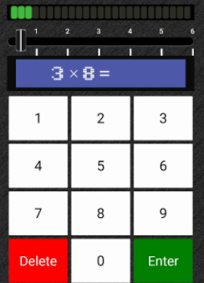
X TABLES
Year 4 GOVERNMENT TESTS (June 2025)
All tables up to 12 x 12
6 seconds
TT Rock Stars
‘SOUNDCHECK’
-92% achieved 22 or more in the final test

