Slide 1
Stoke Bishop Church of England Primary School SEND Information Report
Written in collaboration with parents and children
March 2024

Slide 2
What we do
Our Aim
At Stoke Bishop Church of England Primary School we aim to be fully inclusive, providing an appropriate and high quality education for all children, including those identified as having ‘special educational needs or disabilities’.
We emphasise the importance of Quality First Teaching for all pupils but recognise that some pupils may require additional support to enable them to access the curriculum and make progress.
Our Staff Team
We have an experienced staff team who receive regular training to ensure that they are able to meet the needs of all learners. We have good links with a range of outside specialist agencies, including The Educational Psychology Service, The Autism Outreach Team, Speech and Language Therapists and Physiotherapists. We also employ a range of therapists to help support our children who need more focused support.

Slide 3
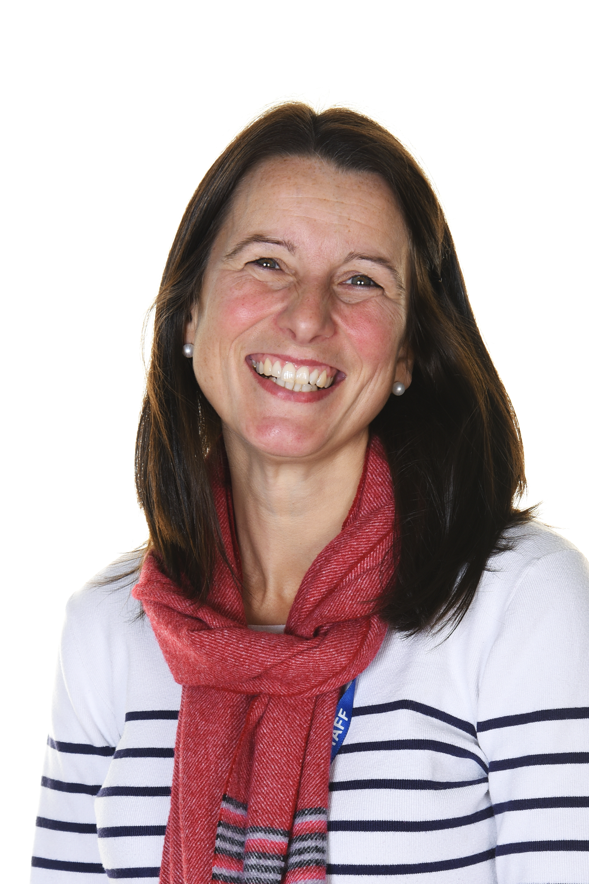
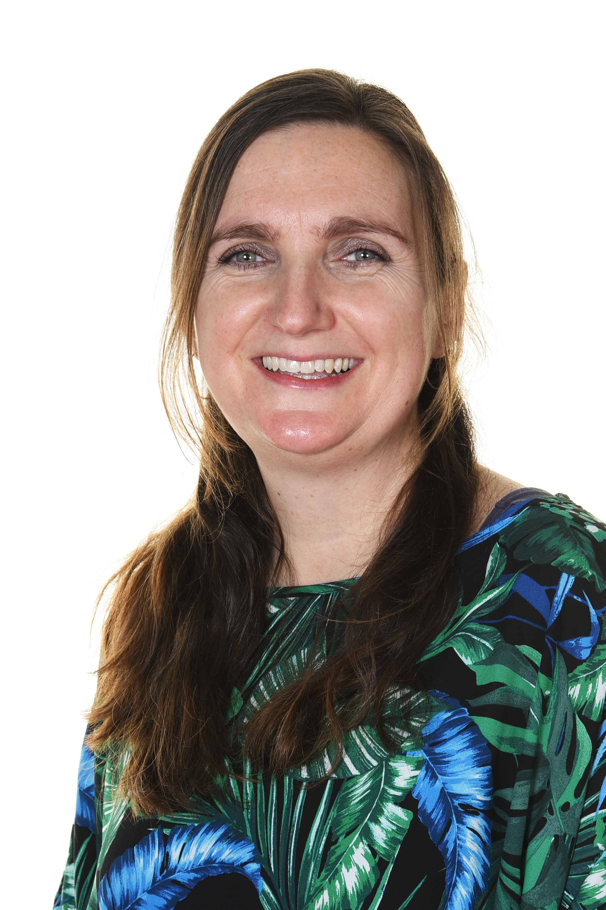
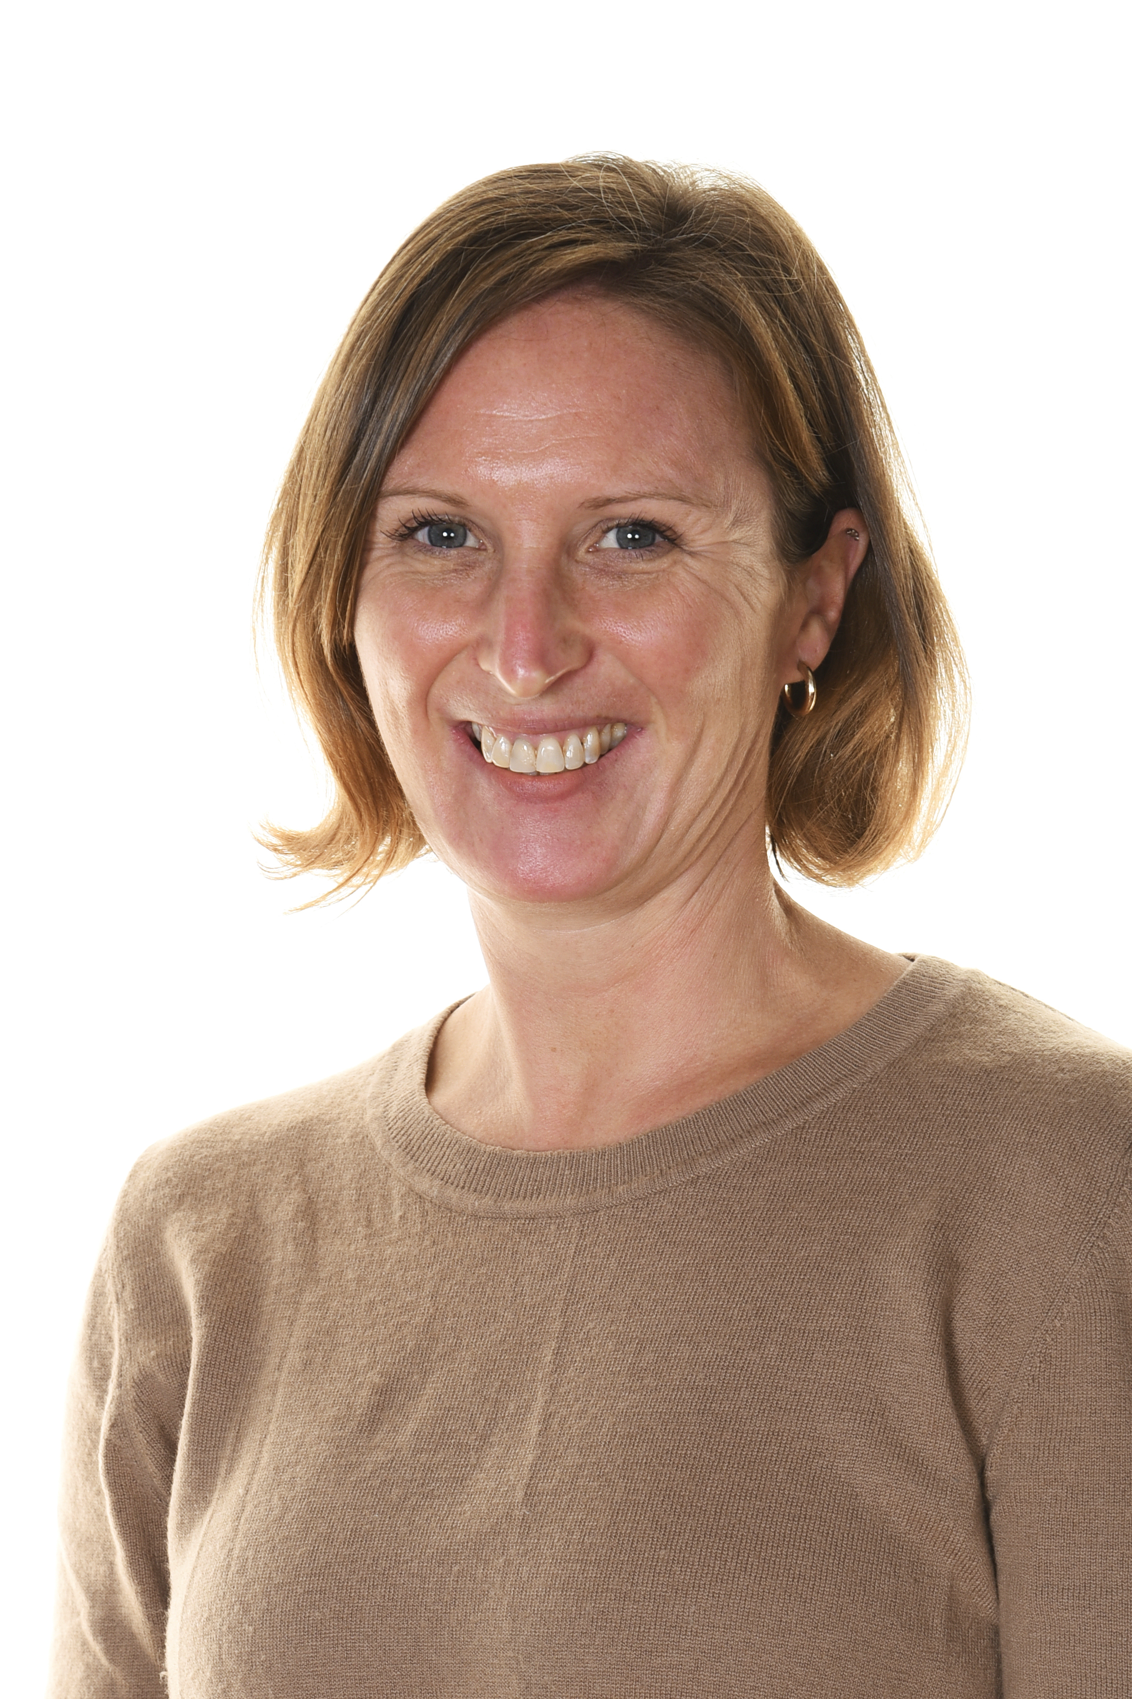
Meet the team
Heather Whittard-Jones – Inclusion Lead
‘I am responsible for co-ordinating and monitoring the delivery of an inclusive education for all children. I provide leadership, support and direction through collaborating with parents/ carers, staff and external professionals. I am passionate about enabling children to understand themselves and celebrate their strengths’.
Heather.whittard-jones@Bristol-schools.uk
Vickie Melton – Pastoral and Safeguarding Lead
‘I work across the school to make sure that all children receive an appropriate and quality PSHE/ RSE curriculum, whilst also ensuring all children are supported and cared for’.
Vickie.melton@Bristol-schools.uk
Claire Woodman-Smith – Family Link Worker
‘I am here to provide support and help for all families that need it. Working together is the best way we can help our children achieve’.
c.woodman-smith@bristol-schools.uk

Slide 4
How does the school know if my child needs extra help?
We identify children with Special Educational Needs and Disability (SEND) by whole-school tracking, monitoring, collaborating with previous settings, medical reports, and the ‘New Arrivals’ Policy.
Your child’s class teacher will continually assess how they are progressing with their learning. If a child is working below age related expectations or is making slower than expected progress, we will consider whether they need extra support. For some children this will become clear very early on their school journey, for others it may not become apparent until later into Key Stage Two.
If your child has been identified as having a Special Educational Need or Disability before they join us, the SENDCo at their previous school or nursery should contact the School and pass on information about your child’s needs.

Slide 5
What should I do if I think my child has Special Educational Needs?

Slide 6
How will the school support my child?
If your child has SEND, they will receive ‘School Support’. This means they will have a Support Plan, drawn up by the class teacher in consultation with you, your child and the SENDCO. (An example of a Support Plan is on the next slide). The plan will identify needs across all areas of SEN; Communication and Interaction, Cognition and Learning, Social Emotional and Mental Health, Sensory and Physical needs.
The Plan will contain targets and outline the strategies and resources that will be used to help your child achieve them through the Assess, Plan, Do, Review Process. The Plan will be reviewed and shared with you and your child at least three times a year.
Pupils with SEND are supported by Teaching Assistants (TAs), additional resources, (such as specialist equipment and IT programmes) and/or interventions from external providers. Pupils are monitored carefully by teachers who will discuss progress regularly with parents and carers.

Slide 7
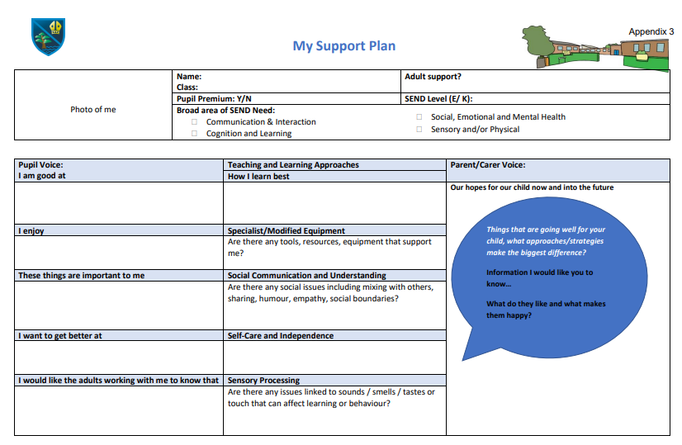
Support Plan template

Slide 8
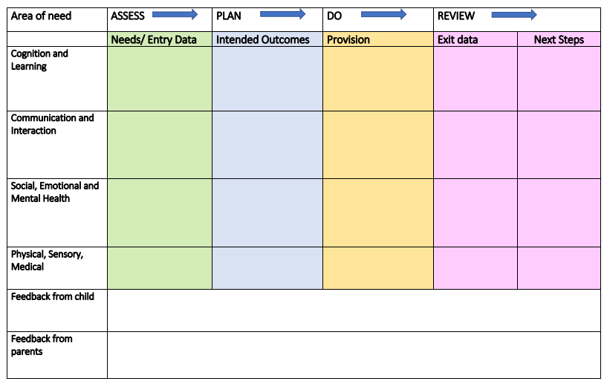
Support Plan template

Slide 9
Children with long term needs and a constant need for coordinated services will receive an EHCP. An EHCP is necessary for specialist provision
Graduated Response
Stoke Bishop Primary School
EHCP/ EHCP
Assessment (0-25)
Educational psychologist input, on-going multi agency input, medical disability with SEN
An EHCP assessment has a 20 week time frame. All phases of a graduated response need to be evidenced before an EHCP assessment can be requested
School Support with External Agencies
Personalised learning inc. specific interventions, Referrals or support
from BAT, SALT, OT, ArtTherapist, Counselling, Educational Psychologist, North Star Outreach, SHIPS, annual reviews, Individual Support Plans, multi agency meetings with parents, support for high needs block funding.
Here are lots of ways that we support our children
SENCO expertise used as part of the graduated response and to coordinate support
School Support
Individual interventions, small group intervention (maths, phonics, social skills), daily reader, Turnabout memory, Nessy, Time to Talk, Boxall Profile strategies, Mastering Number, Precision Teaching, Switch On, Lego Therapy, personalised behaviour strategies, targeted spellings, 1:1 or group SPLD teaching, adapted resources, access to alternative ICT, SENCO input to target setting, Assess, Plan, Do, Review cycle monitored via Support Plans, training for teachers/TA’s, Early Help, individual visual timetables, Calm Corner, Calm Club.
Teachers using Assess, Plan, Do, Review cycle to plan for all children in their class
Quality First Teaching
The great job that we do everyday
High quality teaching regularly monitored by SLT, Hub TA support targeting focus children, high expectations for all, appropriately differentiated work, regular opportunities for Assessment For Learning, guided small group teaching, topic days, SEN friendly classrooms, visual timetables, access to resources to support independent learning including: Numicon, key words, place value cards, scaffold prompts, displays to celebrate success and achievement, next steps for children clearly displayed in books, quality marking for children to see success and make improvements, clear behaviour expectations with rewards and sanctions, vibrant, well balanced and age appropriate curriculum, progress monitored termly, whole school and individual SEN related training opportunities, multisensory learning materials, targeted questioning, staff appraisal and observations, daily reading and spelling

Slide 10
What support will there be for my child’s overall wellbeing?
We have a very holistic approach to education and every member of staff has a responsibility for children’s social and emotional wellbeing and mental health. If you have any specific concerns, do talk to your child’s class teacher.
We recognise how important it is for children with SEN to understand themselves and, more importantly, their strengths. We ensure that there are many opportunities for this to happen across the school, including holding our annual Neurodiversity Day. In addition to this the school is able to provide interventions to support mental health or wellbeing, e.g. sessions with the School Counsellor.
There are always qualified staff who are trained in First Aid and in the administration of medicines. They are on duty throughout the school day, including at break and lunchtimes. If your child has medical needs, they may have a Health Care Plan drawn up. The administration of medication for short term needs is undertaken in line with our Administration of Medication Policy.

Slide 11
What Specialist Services and expertise are available at or accessed by the School?
Our school staff have a wide experience of meeting the needs of all Pupils with a range of SEND. In addition to the SENDCo, there are Teaching Assistants who have been trained in specific Intervention Programmes and many have considerable experience and expertise with meeting a range of pupils’ needs.
The School can access support, where necessary, from a range of external agencies, including: The Sensory Support Service (vision and hearing); Physiotherapists; Speech and Language therapists; Occupational Therapists; Educational Psychologists; Child and Adolescent Mental Health Service; Bristol Autism Team and the School Nurse.
In addition to these the School has a comprehensive package of Therapeutic Interventions including an Art Therapist, a School Counsellor and a Play Therapist. We also have funded additional weekly Speech and Language support for a number of our children.

Slide 12
What training has been provided for the Staff supporting children and young people with SEND?
The SENDCo attends regular training and networking events including, NW24 Cluster Meetings, the annual Bristol SENDCo Conference, Top-Up Funding panel meetings, Designated Teacher training and work involving the HOPE (Bristol’s Virtual School which exists to improve the education of children in care (CiC), and has achieved the NASENCO Masters Qualification at Bath Spa University.
All relevant information is disseminated to Teaching Assistants (TAs) through their weekly meeting and to Teaching Staff through weekly Staff Training.
Whole Staff Training has included Autism Education Trust L1, input from a Specialist Teacher of Dyslexia, a Trauma Informed Approach to supporting children, and Growth Mindset. Additional training is also arranged throughout each term, during which TA’s are released at the same time to attend for example Lego Therapy Training, Speech and Language Training.

Slide 13
How will my child be included in activities outside the Classroom, including School trips?
The School’s Accessibility Plan (available to read on the School’s Website) aims to ensure that all Pupils with SEND are able to fully participate in all learning activities including School trips. Examples of some of the appropriate measures that the School takes include taking extra staff/helpers, taking necessary medication and informing trip providers of disabled Pupils’ needs. Parents/Carers may also be invited to attend with their child. A Risk Assessment is carried out prior to any offsite activity to ensure that nobody’s health and safety will be compromised.

Slide 14
How accessible is the School environment?
Our School is all on one site. The School is built on several levels with small flights of stairs joining each level. Entrance to the main building is through the main lobby, which is ramped and therefore suitable for wheelchair access. Classrooms are accessed by corridors from which there is wheelchair access at each end of the top corridor. There is also a ramp allowing access to the dining hall.
There are two additional blocks; Cedar Block contains 4 classrooms, a workroom and toilets which are all on one level. The second, Oak Block, contains two classrooms and a disabled toilet, which are all on one level and can be accessed via a ramp.
There are currently shower, changing and washing facilities but no laundry facilities. There are accessible toilets in the main building and additional blocks.
Detail of our plans and targets on improving environmental access are contained in the Accessibility Plan available on the school website.

Slide 15
How will the School prepare and support my child to join the School?
We have a detailed transition plan for all children starting in Reception. The Early Years Foundation Stage (EYFS) team visit Pre-School settings to meet children in the Summer Term before they start at the School, and will carry out additional visits if required.
There is a Welcome Meeting for parents/ carers of all prospective new EYFS children in June. The children are invited into school for a number of play sessions in June and July to help to settle them in in September. If your child has been identified as having SEND, the EYFS Class Teacher and/or SENDCo will make contact with your child’s Pre-School setting and attend their final Nursery review. We conduct home visits for every child where we meet the child in their home setting.

Slide 16
How will the School prepare and support my child to transfer to/from another setting?
For pupils who join the School outside the EYFS entry, we follow our New Arrivals Policy. This includes a preliminary half day visit prior to joining for the child to get to know the school and class, and the allocation of a buddy to support their transition. We endeavour to contact the previous setting and for pupils with SEND, will work closely with them and you to ensure the transition is managed in the best way for the child.
When your child is due to move on to a new setting, we will make contact with the school so that we can share information. All Year 6 pupils are prepared for transition in a number of different ways. Most secondary settings send a member of staff to meet the children in their own school setting and meet with the Class Teacher to discuss particular needs. All secondary schools have an Induction Day and many offer additional sessions for children with SEND, which we are able to support in a variety of ways. If required the SENDCO can also arrange joint visits to secondary schools.

Slide 17
How are parents involved in the School?
We are keen to ensure that we have regular contact with parents and that we are able to respond to requests in a timely manner. If you wish to speak to one of us please feel free to get in touch with the School Office or contact us directly by phone or email. We are also often on the playground at the beginning and end of the School day so please do come and find us.
You will have contact with your child’s class teacher through Learning Meetings and through Support Plan meetings that will take place twice times a year. If your child has an EHCP then you will also have an Annual Review meeting where you will meet with your child’s Class Teacher, the Inclusion Lead, and wherever possible the Bristol SEND Inclusion Officer.
We also run termly SEND Parent Events to offer support and guidance in a range of topics. Such events often involve external agencies, e.g. ‘SEND And You’ or ‘Speech and Language Therapy’ (SALT).

Slide 18
What do our parents say?
‘I have nothing but praise for the way that my child has been welcomed and supported from nursery into Stoke Bishop Primary School. Staff have kept us updated every step of the way. The support plan meetings have been positive and useful looking to set targets for the future.’
‘the SENCO works really closely with the class teacher and external agencies so I feel there is a co-ordinated plan for my child’
‘Stoke Bishop school has been so supportive since my child received a diagnosis. His teacher and the SENDCO immediately put together a support plan and provided him with so much actual support in the classroom’.
‘Technology is always available so he can choose which method is appropriate for him and his learning that day. Extra activities, Nordic walking for example, have been such a brilliant addition to his support and his progress at Stoke Bishop. Thank you’.
‘We have been really impressed and reassured about how you have taken our concerns seriously and taken time to put a plan in place for our child. It’s important to us that the focus is on her self-esteem and her enjoyment of school and learning as well as her achieving milestones, and we believe this has been reflected in the support that she is being given. She continues to be really happy at school which is brilliant.

Slide 19
What do our children say?
‘I like Big Play’ – Year R child
‘We get stickers when we read’ – Year 1 child
‘I like that I can use a laptop when I am doing a long write, but that I can also write when I prefer to’ – Year 5 child
‘Learning about electricity was fun’ – Year 4 child

Slide 20
Glossary
SENDCO – Special Educational Needs and Disabilities Coordinator (Heather Whittard-Jones)
EHCP – Education Health and Care Plan – a legal document written by the local authority in conjunction with other adults supporting the child
SALT – Speech and Language Therapist
EP – Educational psychologist
OT – Occupational therapist
BAT – Bristol Autism Team
PT – physiotherapist
APDR – Assess, Plan, Do, Review

Slide 21
Who can I contact for further information?
Your first point of contact for any concerns is your child’s class teacher and/or the Hub leader.
If you have a query about SEND procedures in school or about getting further advice, you can contact the SENDCo, Heather Whittard-Jones on 0117-3772173 or via email: heather.whittard-jones@bristol-schools.uk
For lots of other resources and support please go to our Inclusion Padlet https://padlet.com/InclusionStokeBishop/kw76hroughse7rbv
Stoke Bishop’s SEND and Inclusion Policy is available on the policies page of the school website.

